Slide 1
BALINIT® 新涂层助力齿轮加工
8th June 2017
金敏

Slide 2
Design 设计
Energy Efficiency 节能
Power 动力
Reliability 可靠
Our surface solutions: Your key to success in the face of continuously increasing demands我们的表面处理事业板块：满足不断提升需求的成功关键
Eco-Friendliness 环保
Oerlikon Surface Solutions
Productivity 多产
Presentation Tools & Equipment (04. January 2017)
Notes:
Surface solutions are more and more the key to meeting the growing requirements of today’s and tomorrow’s world
Surface solutions make the difference in productivity for cutting tools but also for metal-working and plastic-processing tools.
Advanced surface solutions as we understand them also make the difference when it comes to clean processes ….. PPD – the plasma nitriding process – replaces hard chrome on large automotive dies
Surface Solutions ... Making a difference in reliability, for example, in ball valves in the O&G industries
Surfaces solutions make the difference in engine performance, in fuel injection and in synchronizing manually shifted gears
Surfaces solutions can make the difference in design, especially when excellent wear resistance is needed as well. →Examples include the metallic golden or black appearance of luxury watches
Surface solutions make the difference in energy efficiency, be it in jet turbines or in industrial gas turbines, with TBC and abradable coatings but also with honeycomb structures for clearance control.

Slide 3
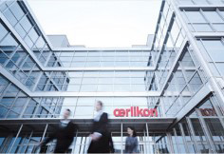
Core expertise: Surface Solutions 核心业务：表面处理
Oerlikon
Group
欧瑞康集团
Surface Solutions
Segment
表面处理事业板块
Manmade Fibers Segment
人造纤维事业板块
Drive Systems Segment
传动事业板块
Sales: CHF 2 671m
销售额：26.71亿 法郎
CHF 1 229m
12.29亿法郎
CHF 794m
7.94亿法郎
CHF 648m
6.48亿法郎
EBITDA: CHF 450m* EBITDA: 4.5亿 法郎
CHF 264m 2.64亿法郎
CHF 128m*
1.28亿法郎
CHF 49m*
4 900万法郎
>13 500 employees
>13 500名员工
> 170 sites 170个服务点
37 countries 37个国家
~CHF 103m in R&D
1.03亿法郎研发费用
* Normalized for restructuring costs of CHF 112 million in Q4 2015, thereof CHF 43 million in the Manmade Fibers and CHF 68 million in the Drive Systems Segment 2015年第四季度规范化重组的成本是1.12亿法郎，其中人造纤维事业部4 300万法郎，传动系统事业部6 800万法郎
Notes:
Source: Oerlikon Corporate presentation as of March 2016

Slide 4
Key facts 重要事实 Surface Solutions Segment表面处理事业板块
6,100employees
6,100名员工
>
1.2bn CHF sales
销售额12亿法郎
Surface Solutions Segment 表面处理事业板块
145 locations
145个服务点
>
140customer centres
140个客户中心
>
37 countries
37个国家
Notes:
Locations = Customer centre + office only
Customer centres = equipment assembly + production centre + service centre + sales office

Slide 5
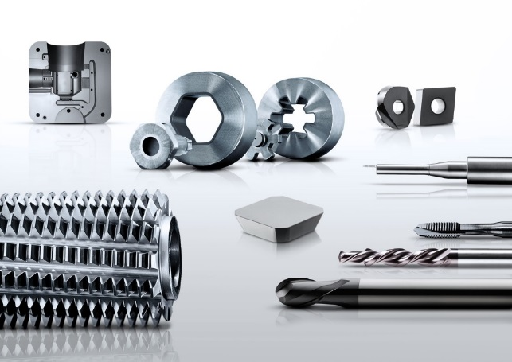
Business Units in the Surface Solutions Segment表面处理事业板块业务单元
Surface Solutions表面处理解决方案板块
Balzers Industrial Solutions
巴尔查斯工业解决方案
Automotive Solutions
汽车解决方案
Metco Aero & Energy
美科航空和能源
Additive Manufacturing
增材制造

Slide 6
Key facts 重要事实 Business Unit Balzers Industrial Solutions 巴尔查斯工业解决方案事业单元
3’000employees
员工3,000多名
>
450million CHF sales 销售额4.5亿法郎
>
1’100systems*
1,100台在运行表面处理系统
>
100 coating centres 100多个涂层中心
>
35 countries 35个国家
33
在巴尔查斯全球工具涂层业务中占比33%
% of all tools worldwide coated by Balzers
Notes:
>1,100 systems refers to ALL Balzers, Metaplas, Schopfheim, Stetten systems within the Balzers coating centre network and at 3rd party customers
>> 33% of coated tools are coated with Balzers over all segments

Slide 7
Balzers Industrial Solutions 巴尔查斯工业解决方案
Balzers Industrial Solutions巴尔查斯工业解决方案
Tools
工具
TF Precision Components
薄膜精密零部件
Equipment & After Sales
设备和售后

Slide 8
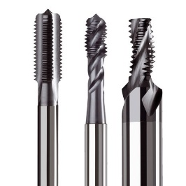
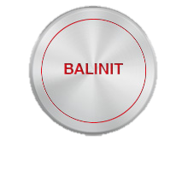
Milestones in our history 我们历史上的重要里程碑
1978
1946
1984
1996
1 Centre
一个中心
4
31
____
Founding of Gerätebauanstalt Balzers
Gerätebauanstalt巴尔查斯成立
____
Kickoff for BALINIT® and IONITRON
推出BALINIT® 和 IONITRON
____
The first coating centres in Italy, Germany, Spain and the USA
意大利、德国、西班牙和美国的四个涂层中心
____
New, high-performance TiAIN coatings
新的、高性能的TiAIN涂层

Slide 9
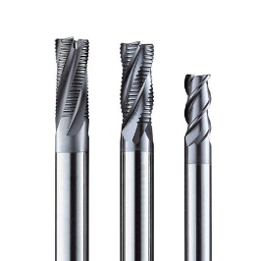
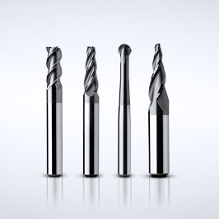
2004
2007
2010
2011
61
81
84
87
____
First generation of AlCrN coatings
____
P3e® technology
____
Introduction of the
new AlCrN coating generation
____
Introduction of the S3p® technology
____
第一代AlCrN涂层
____
P3e® 技术
____
引入S3p® 技术
____
引入新一代AlCrN涂层

Slide 10
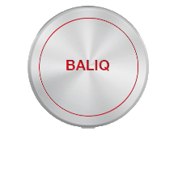
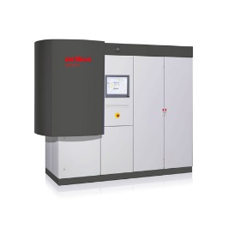
2013
2014
2015
2016
93
>130
145
147
____
S3p® breakthrough and rollout of the new BALIQ® coating generation
____
Founding of the Surface Solutions Segment
____
Integration of Metaplas & introduction of the BALITHERM® brand
____
99 tooling centres with thin-film coating services
____
S3p® 技术取得突破性进展和新一代 BALIQ® 涂层面世
____
99 个工具中心有薄膜涂层服务
____
表面处理事业板块成立
____
整合 Metaplas 并引入BALITHERM® 品牌
Notes:
Since 2014: Balzers & Metco locations are counted
2014: 94 Balzers alone
2015: 107 Balzers alone
2016: 108 Balzers alone (incl. PRC & Automotive)
In 2016: 99 tooling alone without the following PRC & Automotive locations:
BUS Amherst (formerly Metaplas)
BCN Changchun (formerly Metaplas)
BFR Limoges (formerly Metaplas)
BDE Niederwürschnitz (formerly Metaplas)
BDE Salzgitter (formerly Metaplas)
BDE Stollberg
BSK Velka Ida
From the 2015 annual report: OSS: 145 service and production centres. At 149 sites in 37 countries.

Slide 11
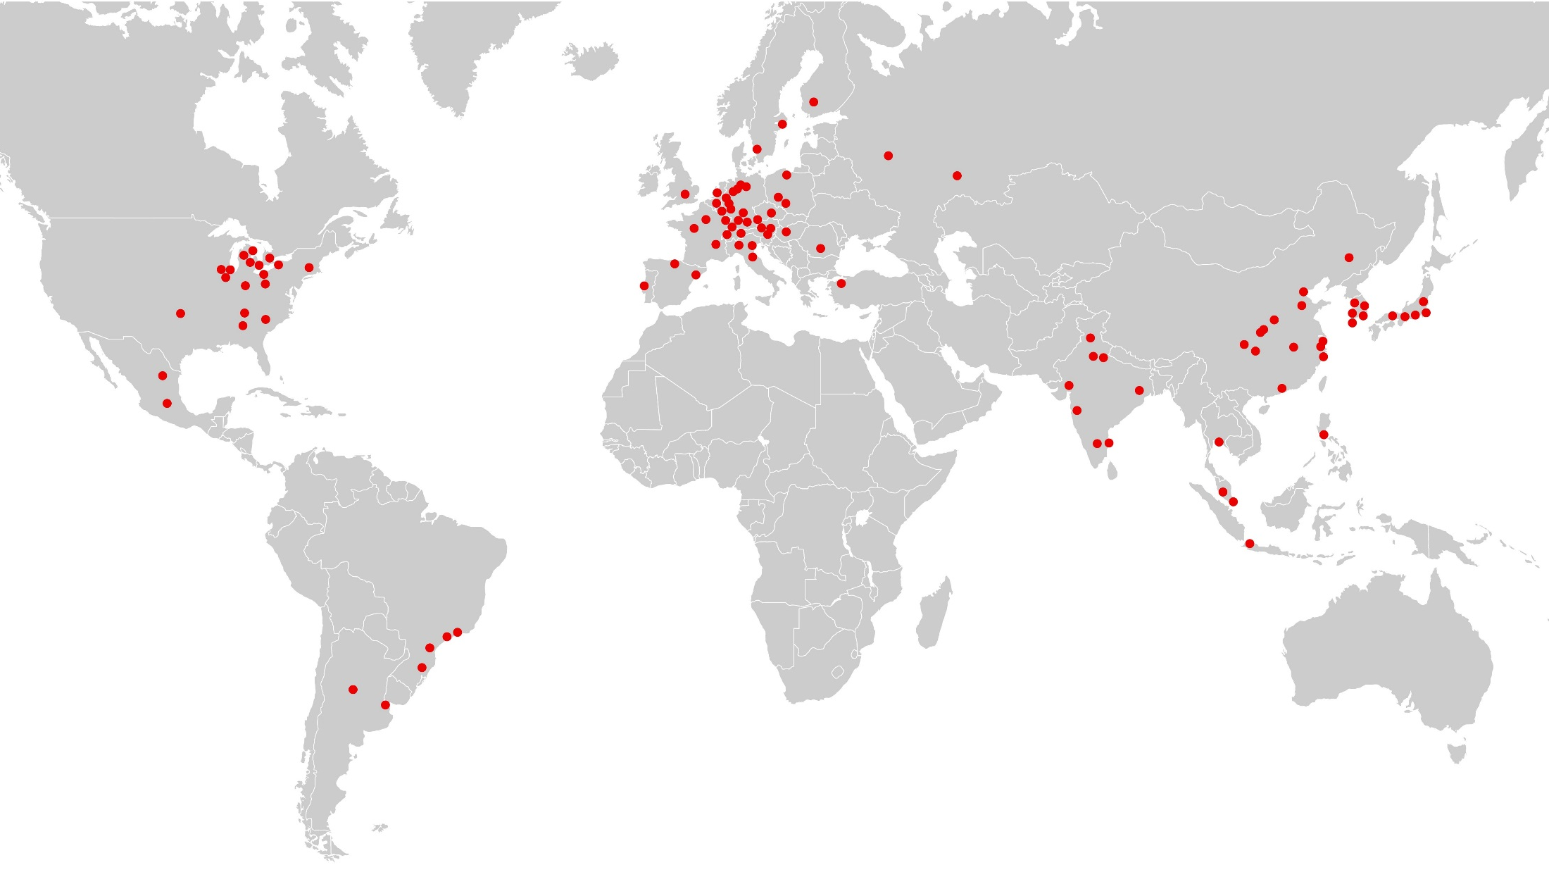
Close to you – Anywhere in the world: The Tools customer centres 在您身边-无论您在何处：工具客户中心
21Centres
42Centres
36Centres
Americas 美洲21个中心
Europe欧洲42个中心
Asia 亚洲36个中心
Argentina 阿根廷
Brazil 巴西
Canada 加拿大
Mexico 墨西哥
USA 美国
Liechtenstein列支敦士登
Benelux 比荷卢
Germany 德国
Finland 芬兰
France 发过
Great Britain 英国
Italy 意大利
Austria 奥地利
Poland 波兰
Portugal 葡萄牙
Romania 罗马利亚
Russia 俄国
Slovakia 斯洛伐克
Spain 西班牙
Sweden 瑞典
Switzerland 瑞士
Czechia 捷克
Turkey 土耳其
Hungary 匈牙利
China 中国
India 印度
Indonesia 印度尼西亚
Japan 日本
Korea 韩国
Malaysia 马来西亚
Philippines 菲律宾
Singapore 新加坡
Thailand 泰国
Notes:
Balzers locations NOT included in this Tooling map:
BUS Amherst (formerly Metaplas)
BCN Changchun (formerly Metaplas)
BFR Limoges (formerly Metaplas)
BDE Niederwürschnitz (formerly Metaplas)
BDE Salzgitter (formerly Metaplas)
BDE Stollberg
BSK Velka Ida

Slide 12
Locations and market regions in China 在中国的地址和市场区域
Cutting Tools
Forming Tools
Components
Low Pressure NItrding
ePD Technology Center
PPD
Reconditioning
Heilongjiang
Changchun
Liaoning
Xinjiang
Beijing
Inner Mongolia
Tianjin
Qinghai
Jinan
Xi’an
Henan
Hanzhong
Shiyan
Suzhou
Xizang
Shanghai
Chengdu
Chongqing
Wuhan
Wenling
Jiangxi
Fujian
Taiwan
12 coating centers in China
As of Oct. 2016, number of employees: 420
截止到2016年10月，中国有12个涂层中心，420名员工
Dongguan
Capital of China
Hainan

Slide 13
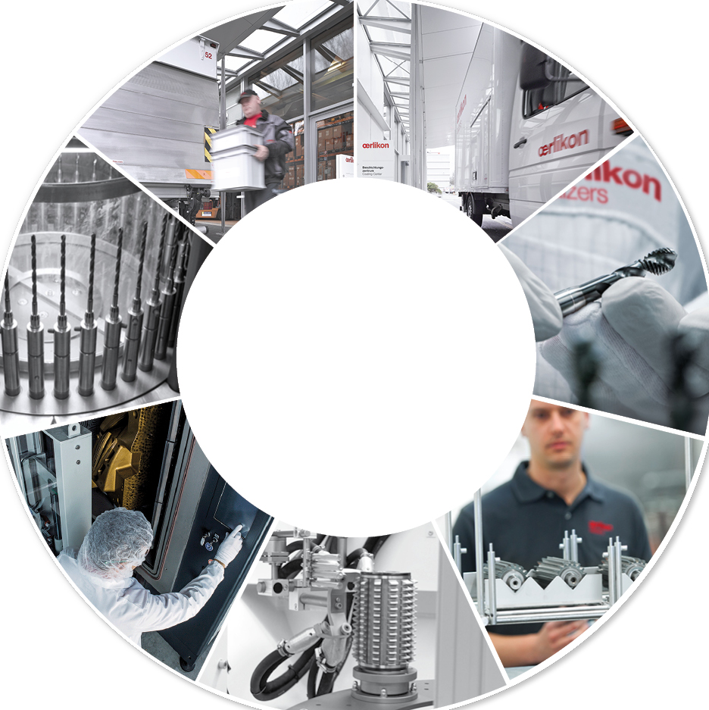
Production workflow for tool coatings 工具涂层生产流程
Pick-up取货
Packaging/Delivery包装发货
The Oerlikon Balzers production process ensures high, reproducible quality all the time – worldwide.
欧瑞康巴尔查斯的生产工艺在全球范围内一直确保高质量、稳定工艺
Incoming Inspection来料检验
Post-treatment 后处理
Cleaning清洗
Coating涂层
Pre-treatment 前处理

Slide 14
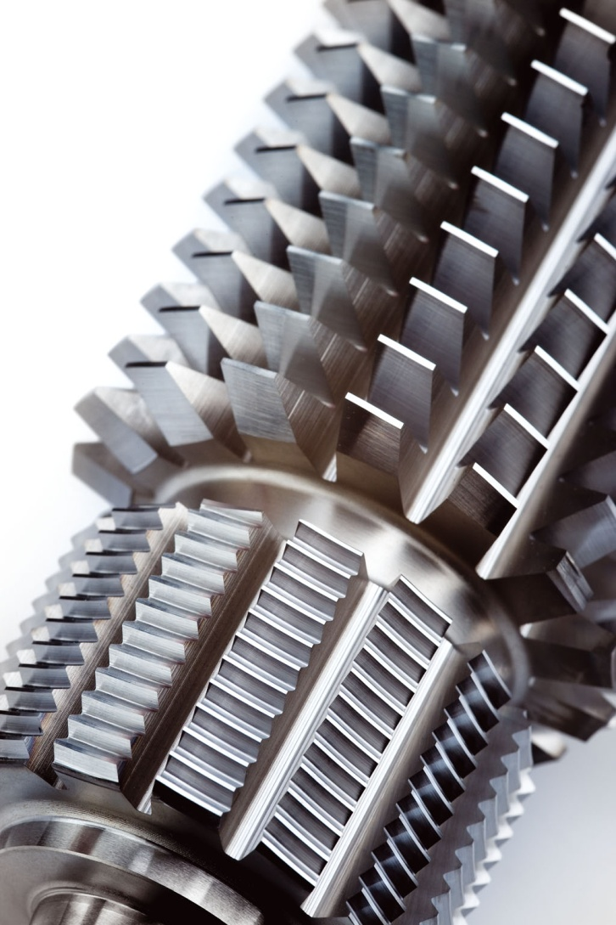
Key statements in gear cutting application 齿轮加工应用中的关键陈述
Market is strongly enduser driven (Automotive companies)市场由强大的终端用户驱使（汽车公司）
First to adapt new coatings最先采用新涂层
Trend to dry machining干式加工的趋势
Reliability of products产品的可靠性
Productivity is most important criterion生产率是最重要的准则

Slide 15
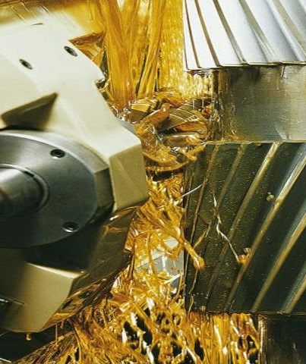
Productivity is the key 生产率是关键
50% increase in tool life reduces costs per piece by 1 % 刀具寿命提高50%，产品单件成本下降1%
30% reduction in tool costs reduces costs per piece by 1 %刀具价格下降30%，产品成本减少1%
20% increase in cutting parameters (depth of cut, cutting speed) reduces costs per piece up to 15% 提高20%的切削参数（切深，切削速度），单件成本减少15%
Picture: http://www.star-su.com

Slide 16
Reduction of manufacturing costs制造成本的减少 Example Gear Cutting齿轮加工案列
 | v_{c} = 150 m / min (module模数 1.75) | v_{c} = 350 m / min (module模数 1.75)
Tool costs刀具价格 (80x200) | 800 € (PM – HSS hob粉末冶金高速钢滚刀) | 1600 € (Carbide hob硬质合金滚刀)
Coating costs涂层费用 | 50 € (low end低端) | 100 € (high end高端)
Tool life / tooth刀具寿命/齿 | 5 m | 5 m
Number of recoatings重涂次数 | 15 | 15
Workpiece / hour工件/小时 | 103 | 143
Costs / workpiece成本/工件 | 0.80 € | 0.63 €
25% reduced production costs, by increased cutting speed! 25%的生产成本下降，来源于切削速度的提高
Notes:
Here we compare manufacturing costs of producing gears by
Machining it at 150 m/ min, with a PM-HSS, and a lower cost coating
Or by machining it at 350 m/ min, with a carbide hob – with double costs, and a more advanced coating
➔ even by using the double expensive hob material and the double expensive coating, we could reduce manufacturing costs by 25%

Slide 17
The acceleration of gear cutting speeds in the last 35 years在过去35年齿轮加工速度的提升
Cutting speed (m/min)
BALINIT® ALCRONA PRO (AlCrN)
?
BALINIT® FUTURA (TiN/TiAN)
BALINIT® FUTURA NANO (TiAlN)
BALINIT® A (TiN)
BALINIT® ALCRONA (AlCrN)
BALINIT® B (TiCN)
1978
1989
1996
2001
2004
2010
2015
Notes:
From the 80s until end of the 90s conventional high speed steel was used, PM-HSS came to the market end of the 90s and in combination with new coatings enabled cutting speeds above 200 m/min.

Slide 18
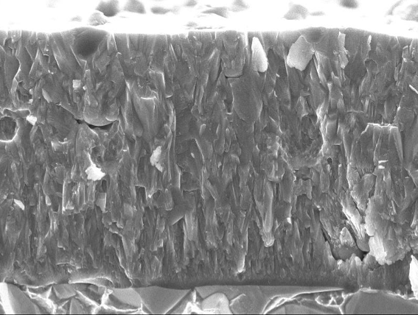
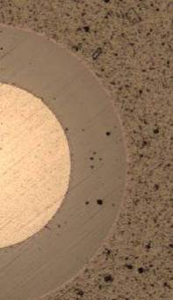
BALINIT® ALCRONA PRO Facts and figures事实和数据
Structure结构 | AlCrN Monolayer
Hardness 硬度HV 0.05 | 3200
Residual stress残余应力 [GPa] | - 3.0
Service temperature 工作温度[°C] | max. 1100
Coefficient of friction摩擦系数 | 0.35
3 µm
BALINIT ® ALCRONA PRO is particularly suitable for:
Operations such as应用于
Milling铣削
Gear cutting齿轮加工
Tapping丝锥
Punching / fine blanking冲头/精冲
Sheet metal forming / extrusion成型
Forging锻造
Materials工件材料
Steel up to 52 HRC 硬度不超过52HRC
Stainless steel不锈钢
Cast iron铸铁

Slide 19
BALINIT® ALCRONA PRO is impressive in hobbing BALINIT® ALCRONA PRO应用于滚刀
No. of parts produced [pcs]
Tool
PM-HSS hob
Workpiece
Steel 1.7131(~AISI 5115)
Cutting parameters
v_{c} = 200 m/min
VB ~ 0.3 mm
Machining
Dry
Source
Automaker
+122%
5,000
4,000
3,000
2,000
1,000
0
AITiN
BALINIT®
ALCRONA PRO

Slide 20
Shift up a gear with BALINIT ALTENSA! 采用BALINIT ALTENSA 提高齿轮加工速度
Cutting speed (m/min)
BALINIT® ALTENSA
1978
1989
1996
2001
2004
2010
2015

Slide 21
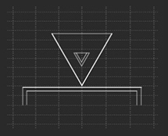
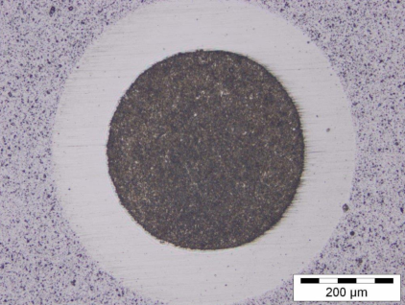
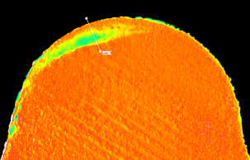
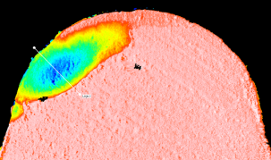
High-end coating properties for high-speed gear-cutting applications高端涂层应用在高速齿轮加工
+ 22 %
hot hardness热硬性
at 700°C
BALINIT® ALCRONA PRO
BALINIT® ALTENSA
+ 35 %
abrasive wear resistance抗磨损
at 25°C
BALINIT® ALCRONA PRO
BALINIT® ALTENSA
1 µm
Optimised优化
crater wear resistance抗月牙哇磨损
BALINIT® ALCRONA PRO
BALINIT® ALTENSA
height (µm)

Slide 22
BALINIT ALTENSA – Benefits at a glance BALINIT ALTENSA—优势一瞥
Improved hot hardness改善热硬性 | > | Reduced wear at high cutting speed 高速加工时减少磨损
Increased abrasive wear resistance 提高耐磨损能力 | > | Reduced flank wear at moderate and high cutting speed 在中速和高速加工下减少后刀面磨损
Lower thermal conductivity 低的热传导率 | > | Reduced thermal impact on tool substrate (especially for PM-HSS) 在刀具基体上减少热影响（特别是PM-HSS)
Optimised oxidation resistance 优化抗氧化能力 | > | Longer tool life at dry cutting conditions and high cutting speed 长的刀具寿命在干式和高速加工
Improved tool life at moderate cutting speed在中速加工时提高刀具寿命 Significant improvement for highest cutting speed conditions for all substrate materials (PM-HSS, MC90, carbide) 有效改善各种刀具材料的最高的切削速度（PM-HSS,MC90,硬质合金） Enables higher cutting speeds and increase in productivity 更高的切削速度和提高生产率

Slide 23
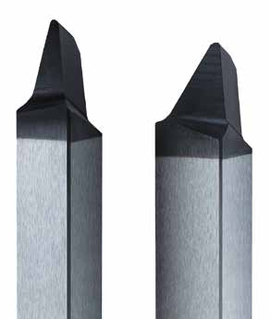
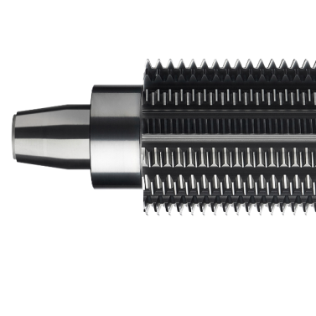
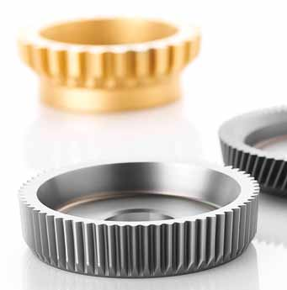
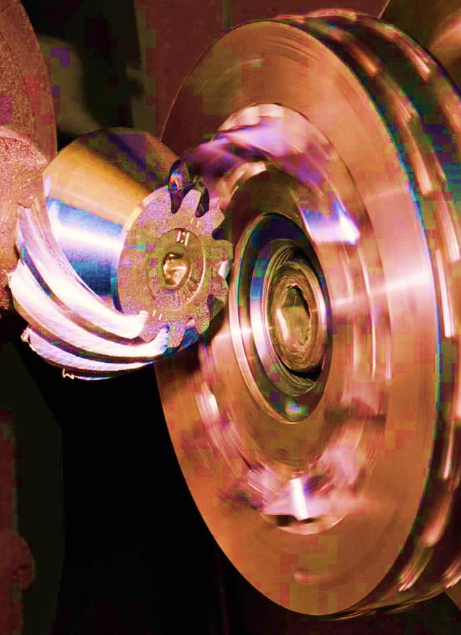
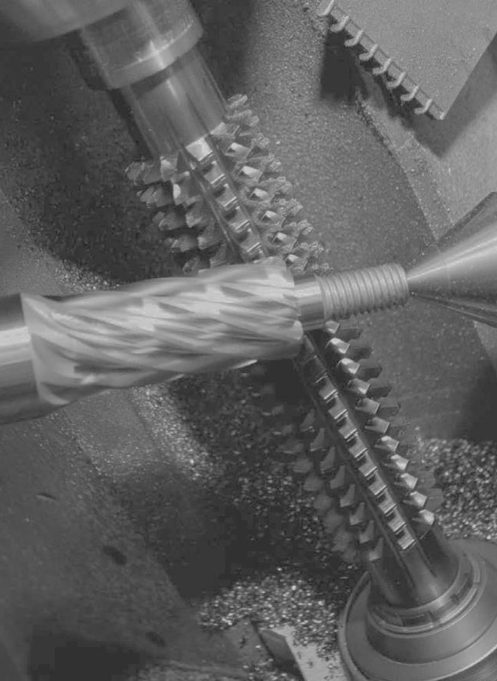
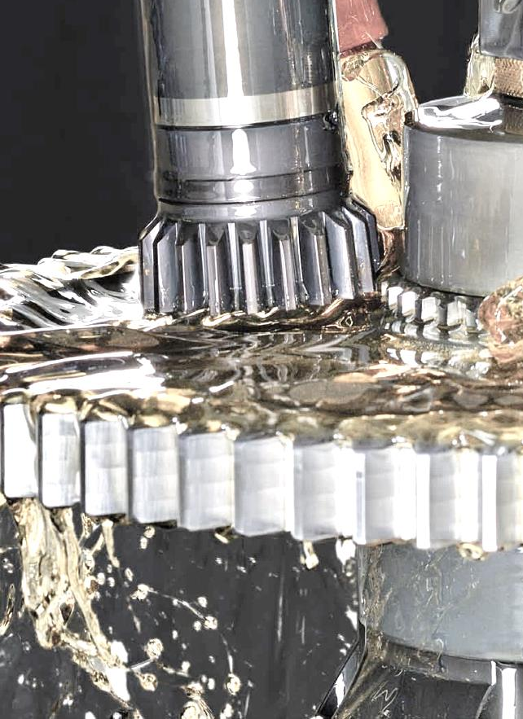
BALINIT ALTENSA impresses in various high-end gear-cutting applications BALINIT ALTENSA应用于各种高端齿轮加工
Bevel gear
cutting
Hobbing
Gear
shaping

Slide 24
Lab tests: convincing results at high-speed cutting 实验室测试：在高速加工中令人信服的结果
Tool: PM-HSS hob (S390)
Workpiece: Steel 1.7131 (AlSI 5115)
Cutting data: v_{c}= 260 m/min m_{n} = 2.56 f_{a} = 4.8 mm H_{cu,max} = 0.25 mm dry
Benefit: +60% tool life at high cutting speed
Source: Oerlikon Balzers WZL Aachen
Tool life (m/tooth)
+60%
BALINIT® ALCRONA PRO
BALINIT® ALTENSA
Notes:
Schicht entwickelt und an Instiut gestestet bei höheren Schnittgeschwindigkeiten, vielversprechende Resultate

Slide 25
Customer test 1: 30% increase in cutting speed results in 20% longer tool life 客户测试1：切削速度提高30%，结果提高20%刀具寿命
Tool: PM-HSS hob (S390) D = 90 mm
Workpiece: Steel 1.7131 (AlSI 5115)
Cutting data: v_{c}= 200 ➔ v_{c} = 260 m_{n} = 1.62 f_{a} = 6.0 mm dry Gearbox for passenger car
Benefit: +30% cutting speed and > 20% longer tool life
Source: Automotive Enduser
Tool life (no. of gears)
+22%
V_{c =} 260 m/min
2,200
2,000
V_{c}= 200 m/min
1,800
1,600
1,400
1,200
1,000
800
600
400
200
0
BALINIT® ALCRONA PRO
BALINIT® ALTENSA
Notes:
Anschliessend erster Versuch bei Kunden mit 260m/min , Ergebnis konnte reproduziert werden, und zeigt Potenzial nach oben …

Slide 26
Customer test 2: Increasing the speed to 300 m/min – still the same long tool life 客户测试2：速度提高到300米/分钟—相同的刀具寿命
Tool: PM-HSS hob (S390) D = 90 mm
Workpiece: Steel 1.7131 (AlSI 5115)
Cutting data: v_{c} = 200 ➔ v_{c} = 300 m_{n} = 1.62 f_{a} = 6.0 mm dry Gearbox for passenger car
Benefit: +50% cutting speed at same tool life
Source: Automotive Enduser
Tool life (no. of gears)
2,100
V_{c}= 200 m/min
V_{c =} 300 m/min
1,800
1,500
1,200
900
600
300
0
BALINIT® ALCRONA PRO
BALINIT® ALTENSA
Notes:
In der 2. Testreihe Geschwindigkeitserhöhung auf 300 m/min, Ergebnis ergab: tool life gleichbleibend hoch

Slide 27
Speeding up to 300m/min results in 20% savings in machine costs 速度提高到300米/分钟的结果节省了20%的生产成本
Machine costs for 1,800 gears (€)
BALINIT® ALCRONA PRO
288 €
savings with BALINIT® ALTENSA
BALINIT® ALTENSA
Notes:
Assumptions:
machine costs per hour 80 EUR
machining time at 200 m/min = 0.56 min/ gear
machining time at 300 m/min = 0.46 min/ gear
Cost savings 288 EUR
Fair sharing of cost savings?
150 EUR additional coating costs per hob

Slide 28
PM-HSS hob: Confirmed results at high speed PM-HSS滚刀：在高速加工下验证的结果
Tool: PM-HSS hob (S390) D = 70 mm
Workpiece: Steel 1.7131 (AlSI 5115)
Cutting data: Cut 1: v_{c} = 200 Cut 2: v_{c} = 320 m_{n} = 1.52 dry Gearbox for passenger car
Benefit: +70% tool life
Source: Automotive Enduser
Tool life (no. of gears)
4,500
+70%
4,000
3,500
3,000
2,500
2,000
1,500
1,000
500
0
BALINIT® ALCRONA PRO
BALINIT® ALTENSA

Slide 29
Thank you! 谢谢！ Time for questions and answers 提问回答时间

